Slide 1
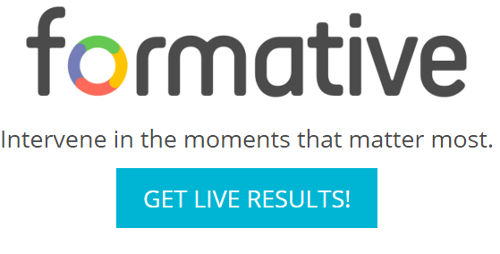
Go Formative
Brian Novick
February 4, 2016

Slide 2
Today…
How can you use Go Formative in your class?
Where should you start?
What tips do you have for a first time user?

Slide 3
How can you use Go Formative in your class?

Slide 4
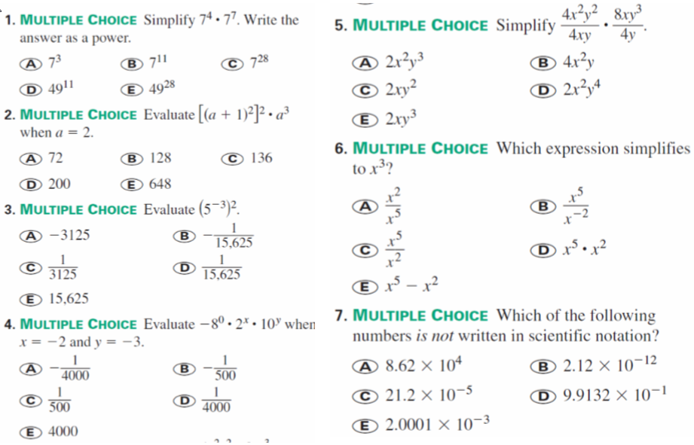
Assigned
Homework

Slide 5
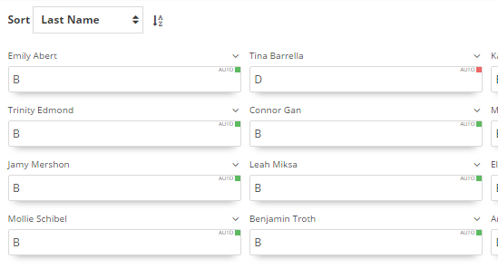
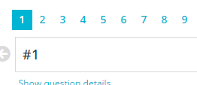
Multiple Choice
Results in
Go Formative

Slide 6
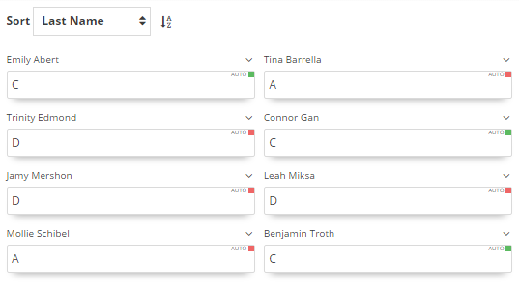
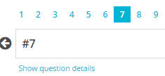
Multiple Choice
Results in
Go Formative

Slide 7
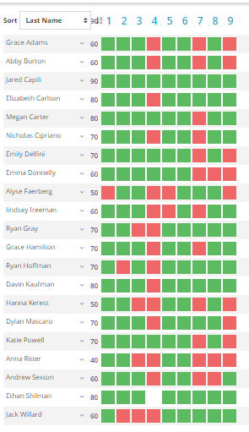
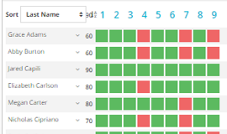
Entire Class Results in
Go Formative

Slide 8
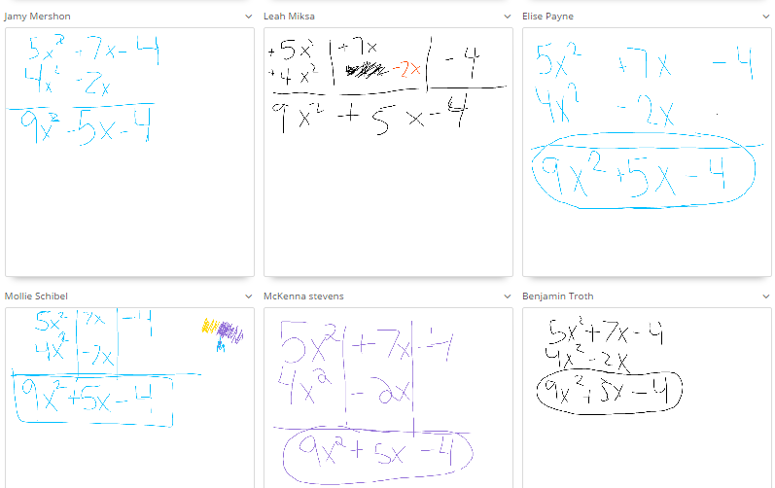
Open Ended Results

Slide 9
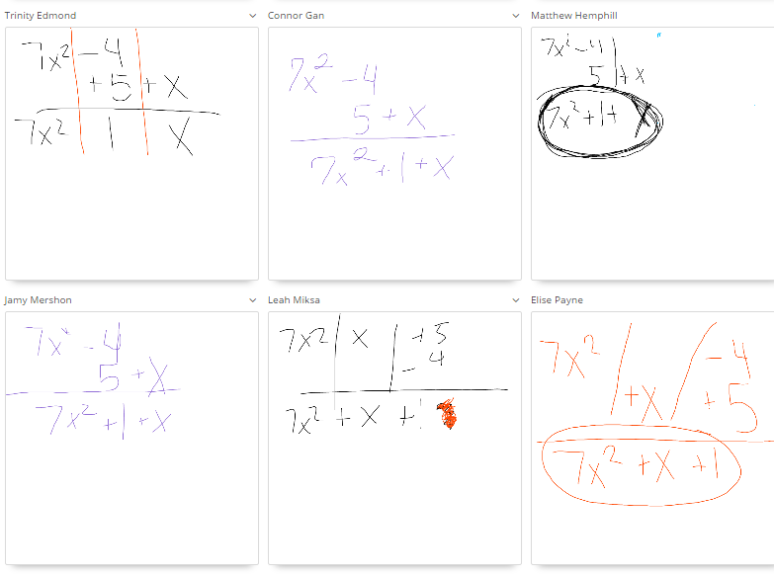
Open Ended Results

Slide 10
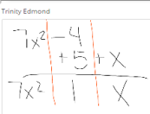
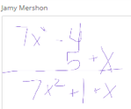
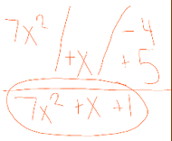
Open Ended Results

Slide 11
How can you use Go Formative in your class?
Formative Assessment
“Formal and Informal Checks for Understanding”
Review Homework
Exit Slip
Real Time Intervention
Determine where to go next in your lesson.
Visually see who needs help.
SUMMARY

Slide 12
Where should you start?

Slide 13
Where should you start?
Create an account at Go Formative.com
Create New Class
5 Ways to Enroll your students
I recommend students joining your class themselves
Display your class code
Direct students to www.goformative.com/#signup
Students sign-up and enter your Class Code
Create Assignments (Dashboard)

Slide 14
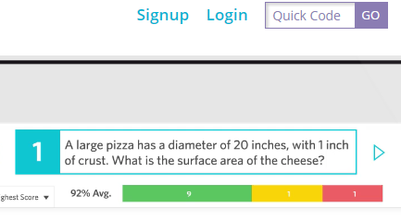
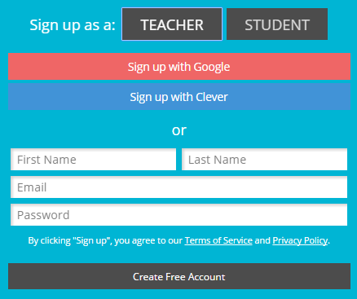
Where should you start?
Step 2: Pick Teacher
Step 1: Sign-Up
Step 3: Fill out the form and click
‘Create Free Account’
Create an account

Slide 15
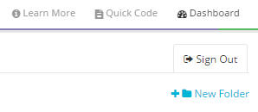
Where should you start?
Create a new class
Step 1: Go to the Dashboard
Step 2: Click Classes
Step 3: Click Create New Class
(a Class Code will be created)

Slide 16
Where should you start?
Step 1: Go to the Dashboard
Create assignments
Step 2: Name the assignment and click ‘Add Question’
Step 3: Determine the type of question (MC, Open Ended, T/F)

Slide 17
What tips do you have for a first time user?

Slide 18
What tips do you have for someone getting started?
Use Google Chrome
Take advantage of the speed of the touch screen laptops.
Have students register for the site after they finish a test/quiz. Use the class code.
You do not have to enter all of your questions on the web site. You can enter “#1” on the site and then project the question.

Slide 19
Today…
How can you use Go Formative in your class?
Where should you start?
What tips do you have for a first time user?

